Slide 1
The Process of Change
This slide deck connected with change. Change can be hard for organizations.
Please feel free to use any of this as a starting point for training, teaching.
Notes:
Spiritual Empowerment
RELATIONAL EMPOWERMENT-
Economic Empowerment
EMPOWERMENT-
TO INVEST WITH LEGAL POWER//AUTHORIZE
TO GIVE MEANS, ABILITY OR OPPORTUNITY
We are only going to work in the realm of relational empowerment:
Today is about you and God and what God has for YOU!!!
-

Slide 2
FOUNDATION-BASIS
PHIL 3:12-14
Not that I have already attained or am already perfected; but I press on that I may . . .
Forgetting those things, which are behind, and reaching forward to those things which are ahead. I press toward the goal for the prize of the upward call of God in Chris Jesus.
Notes:
PHILLIPPIANS IS THE EPISTLE OF JOY AND ENCOURAGEMENT IN THE MIDST OF ADVERSE CIRCUMSTANCES
CENTER YOUR ACTIONS/THOUGHTS ON PURPOSE
STIR UP THE POWER GOD HAS GIVEN YOU TO GET. . . . .
IMITATE CHRIST IN HIS HUMILITY AND SERVANTHOOL
SEEK HIM
BE STEADFAST
BE OF THE SAME MIND
REJOICE ALWAYS
PRAY

Slide 3
Hosea 4: 6
My people are destroyed from lack of knowledge!
Change starts one day at a time- START!!
Become the right person, stop looking for the right person.
MAXIMIZE THIS MOMENT!!!
Notes:
MAXIMIZE THIS MOMENT!!!!!
MAKE THE BEST OF THIS TIME AND GROW FORWARD
DON’T ALLOW ANYONE TO STEAL YOUR MOMENTS
MONEY YOU CAN REPLACE
TIME IS NOT REPLACEABLE
RELATIONSHIPS ARE CRITICAL
MY FEELING
“IT IS BETTER TO HAVE LOVED AND LOST THAN TO HAVE NEVER LOVED AT ALL.”
DON’T BE AFRAID OF OPENING UP NEW
FRIENDSHIPS MALE AND FEMALE
NEVER ENTER INTO COURTSHIP WITH SOMEONE THAT IS NOT YOUR FRIEND!!!!
TAKE EVERY MOMENT AND CRAW WALK OR RUN INTO YOUR
DESTINY YOUR PURPOSE
JUST MOVE FORWARD

Slide 4
Change can mean Growth
Renew Your Mind
  You can change with God
  You can’t change anyone else
  Change you
  Change is a process
  Change starts within

Slide 5
Grow out of your current
Wine Skin
Obedience is better than sacrifice
Faith is the substance of things hoped for and the evidence of things not seen
  I believe Lord!
  It will work if you work it!!
God gives power to get. . . . . . . . . . . . . . . .
  Power is potential
  Abundantly and exceedingly more than………
Notes:
I BELIEVE I BELIEVE I BELIEVE
I BELIEVE = FAITH
DOING = WORK
GOD GIVES POWER TO GET. . . .
Let’s not focus on things (nothing related to Money)
Write it down
WHAT ARE YOU GOING TO DO WITH THAT POWER

Slide 6
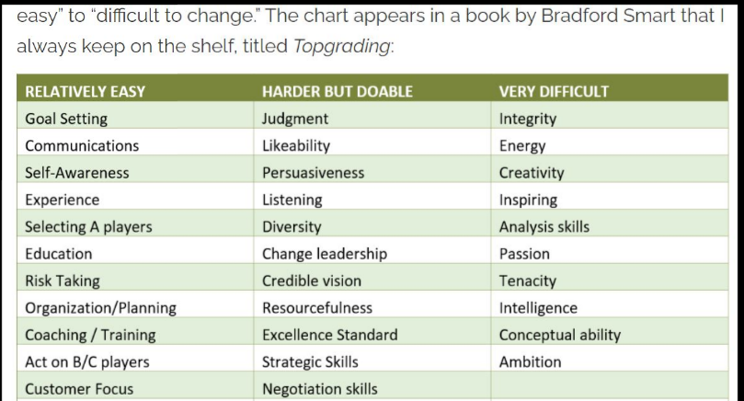

Slide 7
Title and Content Layout with SmartArt
Step 1 Title
Task description
Task description
Step 2 Title
Task description
Step 3 Title
Task description
Task description
Task description

Slide 8
Thank you for being a valued client
This is meant to give some ideas to building deeper content
Enjoy and build and personalize as appropriate for your ministry and or organization
Do you or your team need custom training please contact us
Any suggestions, questions, or concerns please reach
support@4RiversConsultants.com

